Slide 1
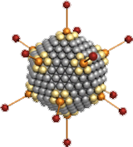
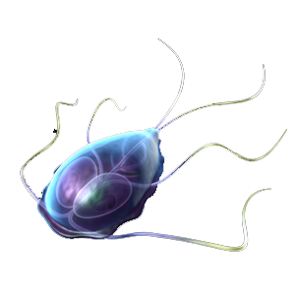
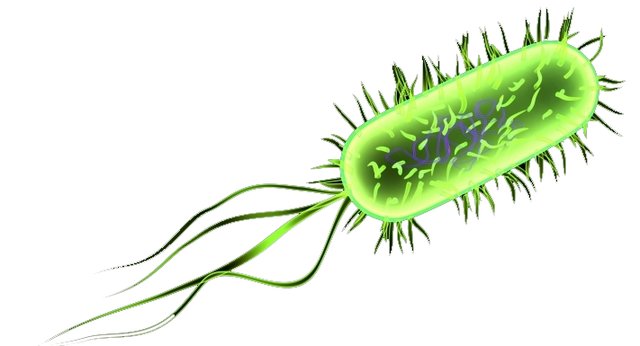
Waterborne pathogens: evolution of prevalence and current challenges
Henry-Michel CAUCHIE
2. Fachsymposium "Spurenstoffe und Krankheitserreger im Wasserkreislauf„
Belval Luxembourg
October 2nd, 2019

Slide 2
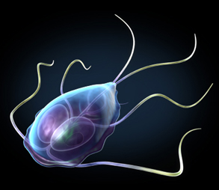
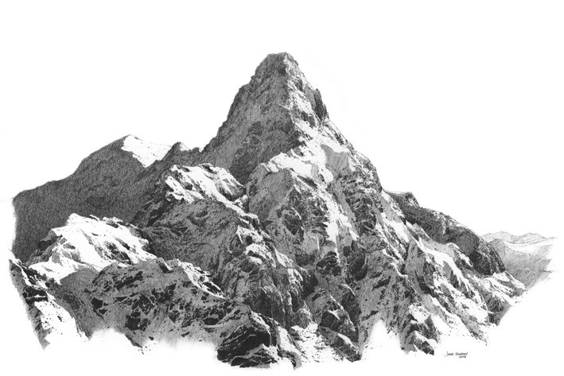
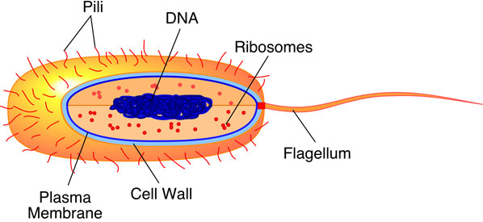
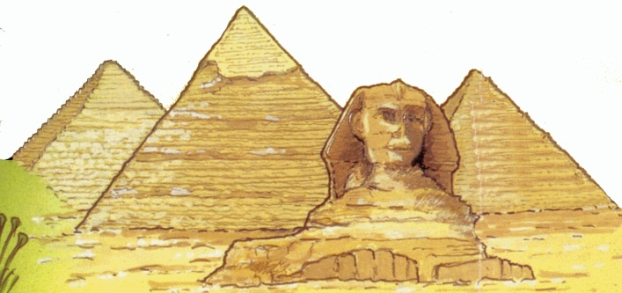
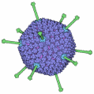
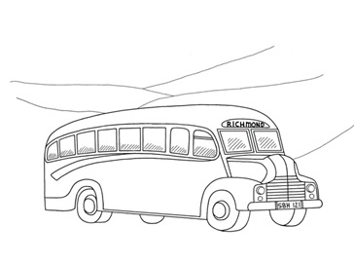



Water-related pathogens
Parasites
5 - 15 µm
Bacteria
500 nm - 3 µm
Viruses
20-100 nm

Slide 3
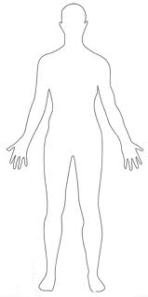

Water-related pathogens
ORAL
Vibrio cholerae
Pathogenic E.coli
Norovirus
Enterovirus
Campylobacter spp
Cryptosporidium parvum
Giardia lamblia
FECAL

Slide 4
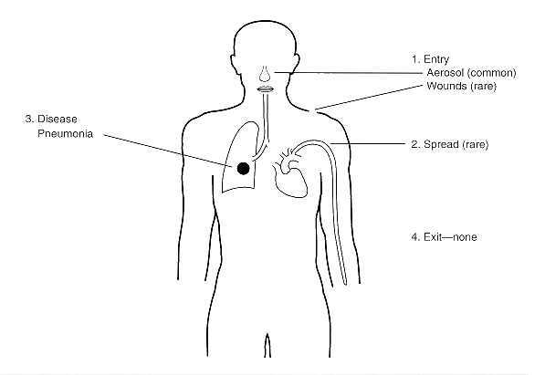
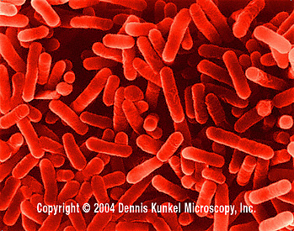
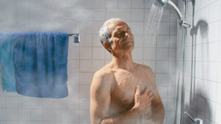
Legionella pneumophila
Optimal development temperature around 42°C (association with biofilm)

Slide 5
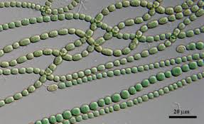
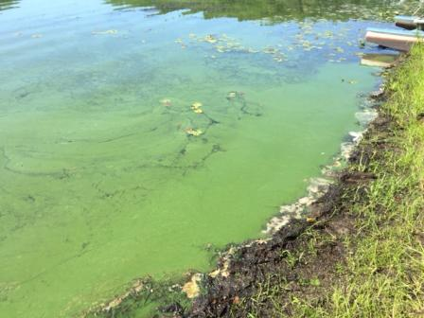
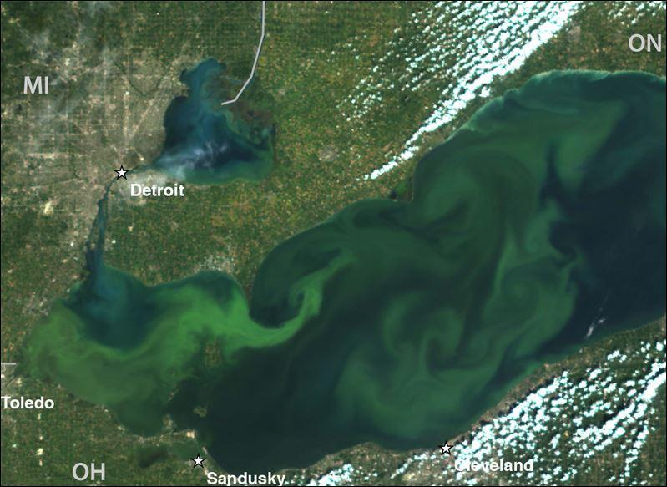
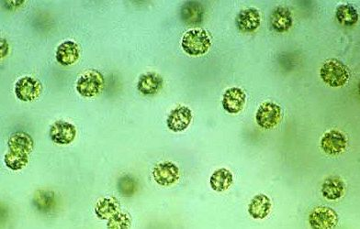
Cyanobacteria
Hepatotoxins
(microcystins)
Neurototoxins
(Saxitoxin
Anatoxin-a)
Dermatotoxins
(lungbyatoxin)
Cytotoxins
(cylindrospermopsin)
Notes:
So we have the suspect. But the first thing is to know the prevalence

Slide 6
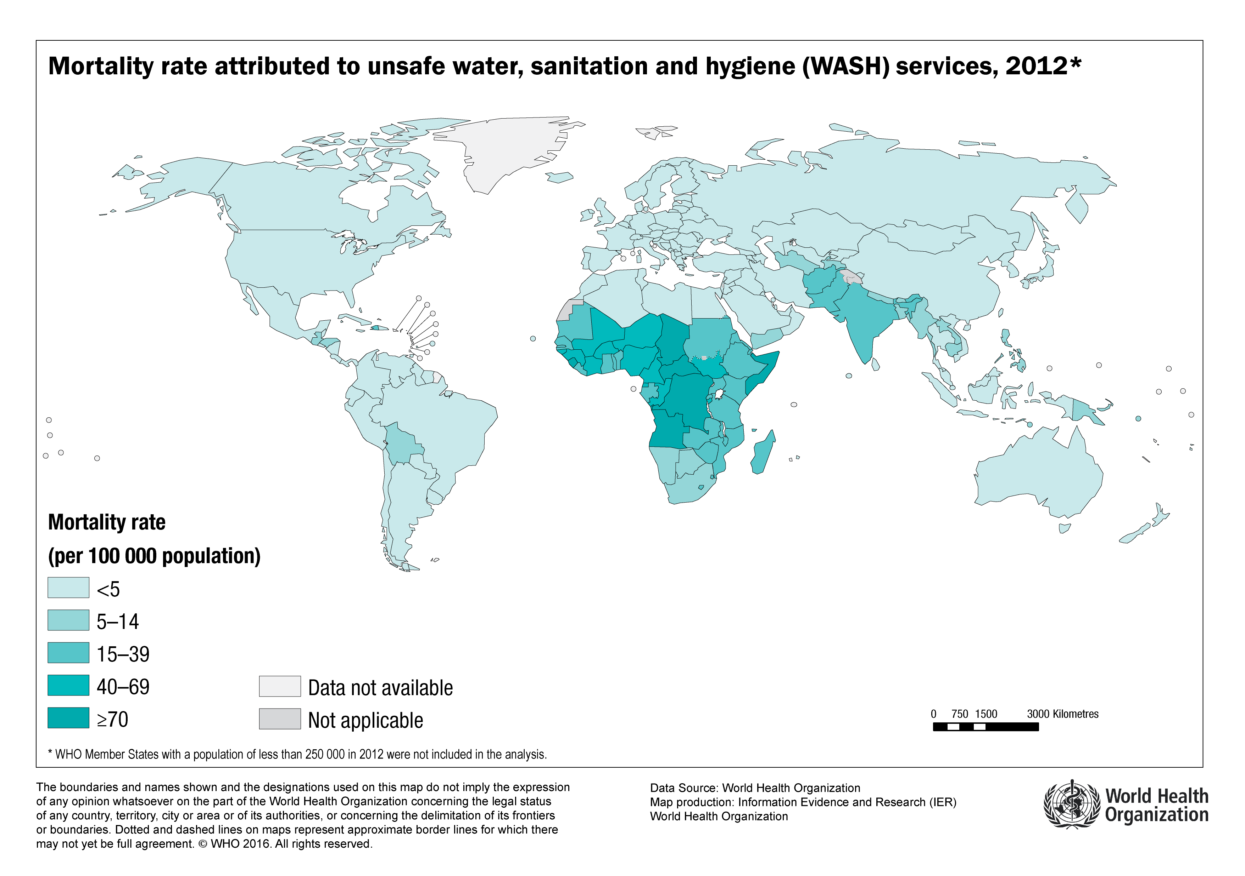
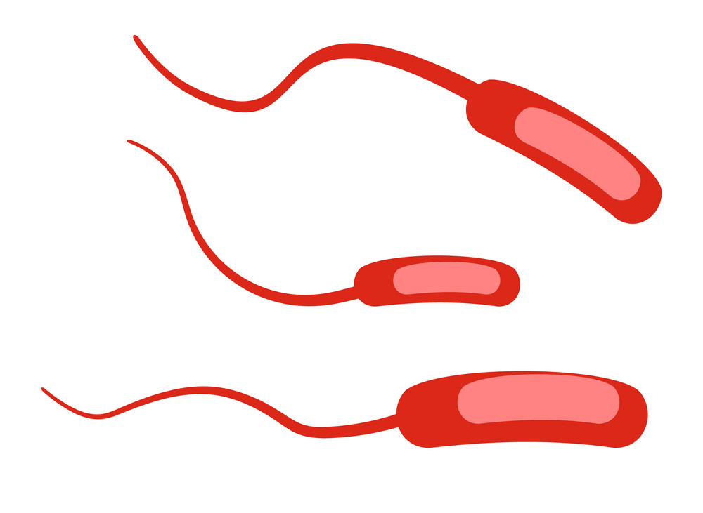
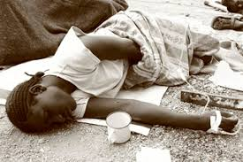
Pakistan ~ 37,000 deaths per year
Nigeria ~ 120,000 deaths per year
India ~ 250,000 deaths per year
Vibrio cholerae
Ethiopia ~ 42,000 deaths per year
DRC ~ 42,000 deaths per year
Notes:
http://gamapserver.who.int/mapLibrary/Files/Maps/Global_WASH_Mortality_2012.png

Slide 7
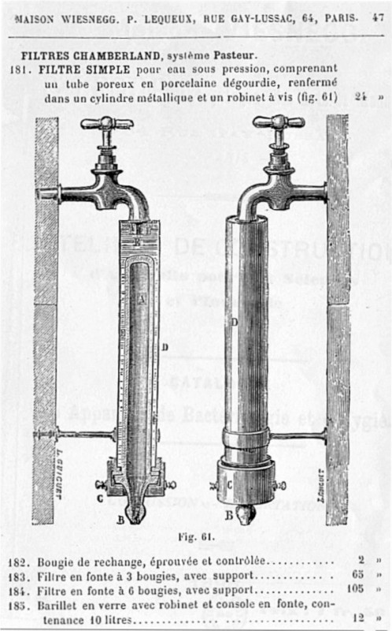
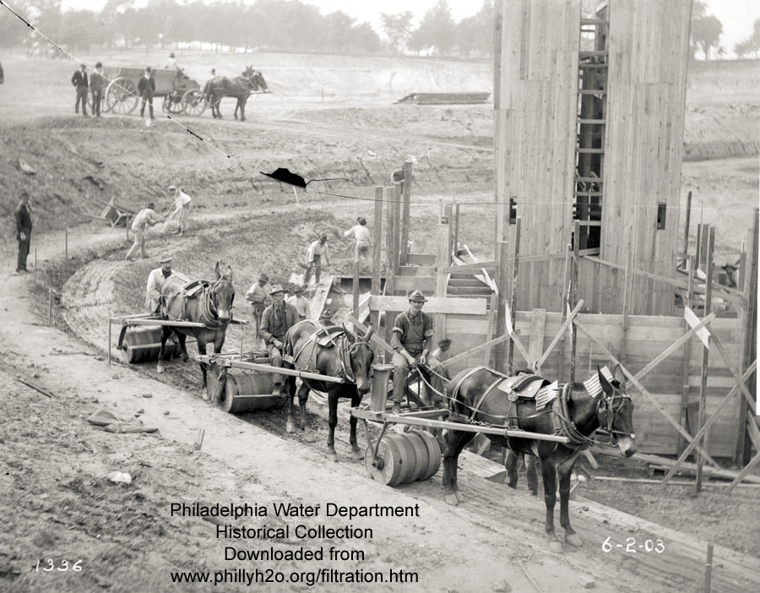

Slide 8
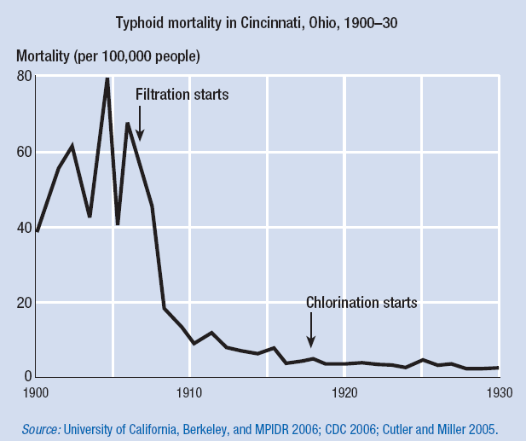
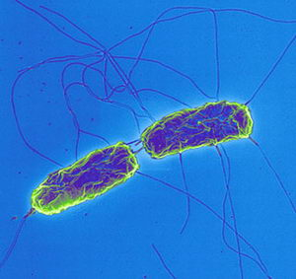
Salmonella typhi

Slide 9
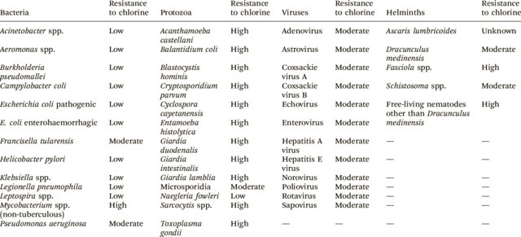
Drinking water treatment

Slide 10
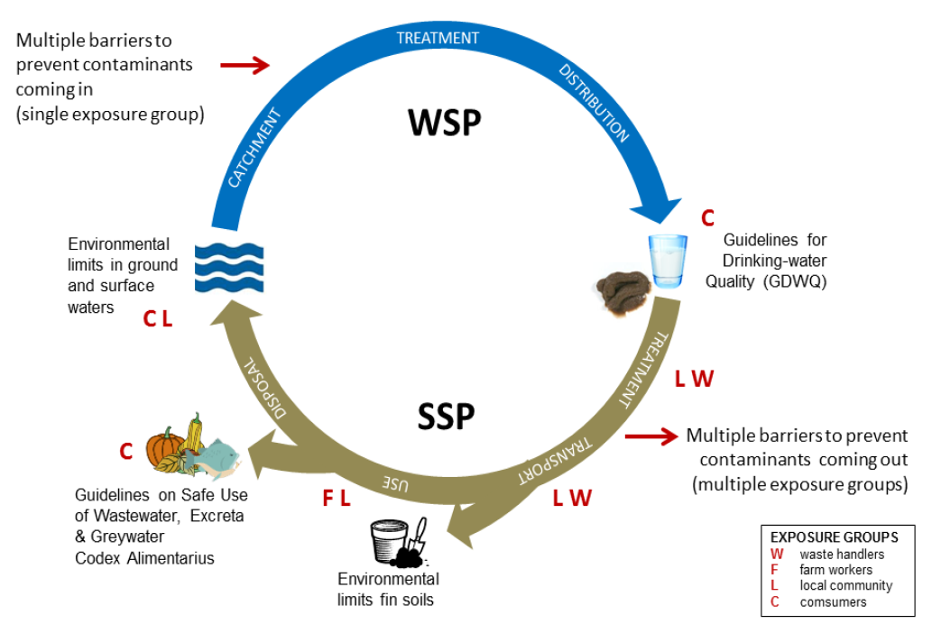

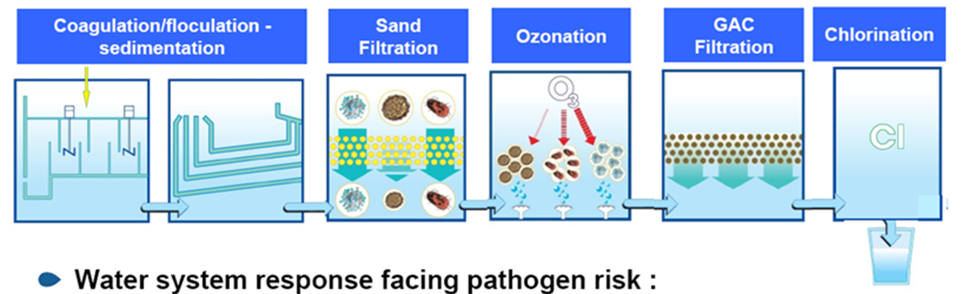
Water Safety Plan
Water Sanitation Plan

Slide 11

Dynamics of outbreaks in the US (1971 – 2014)
Milwaukee outbreak
400,000 people infected
Deaths of eldery and immunocompromised people
Walkerton outbreak
E coli O157; Campylobacter jejuni
2,300 infected/5,000
7 deaths
1971 – 2014
n = 968

Slide 12
Dynamics of outbreaks in the US (1971 – 2014)

Slide 13
Dynamics of outbreaks in the US (1971 – 2014)

Slide 14
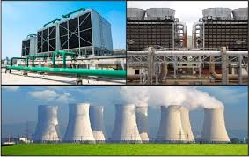
Challenges in drinking water safety
Global implementation of the Water safety plan
  Techniques available
  Improvement on governance
Implementation of the multiple barrier approach
  Adapted to the actual microbial hazard
  → implementation of molecular biology tools in the monitoring labs
  → Adoption of the Quantitative Microbial Risk Assessment
Emergence of Legionella as a major health problem but linked to specific water infrastructure

Slide 15
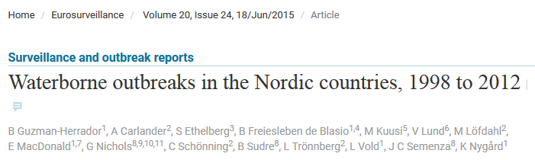
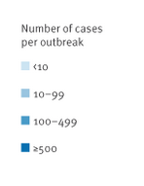
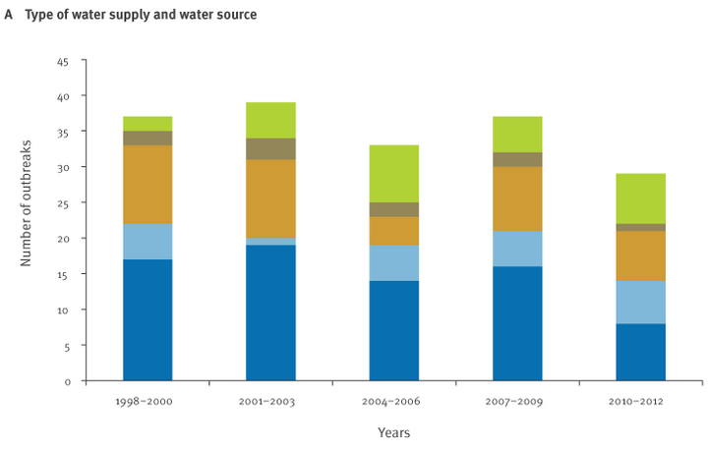
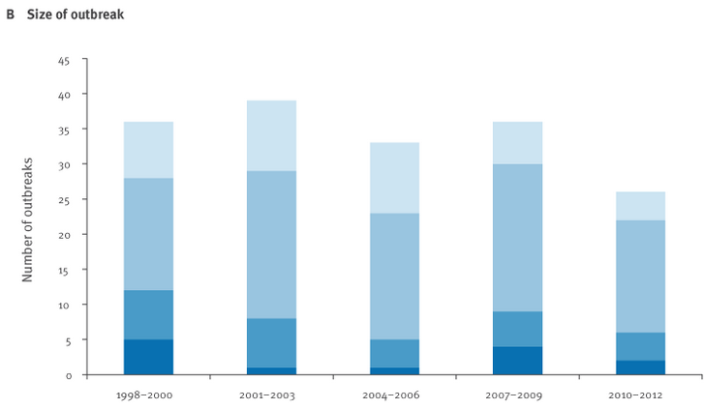
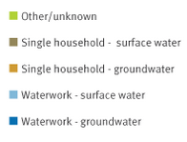

Slide 16
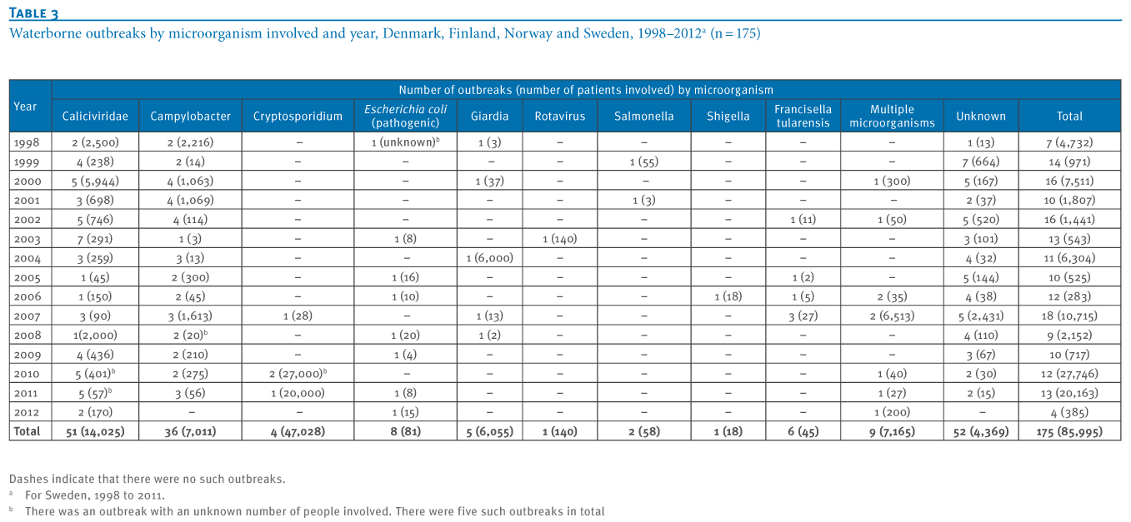
Major ethiologic agents today
Norovirus
Cryptosporidium/Giardia
Campylobacter

Slide 17
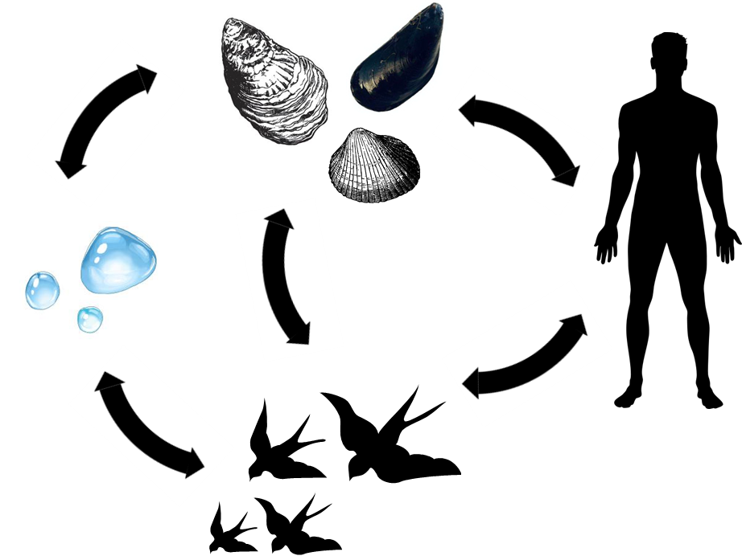
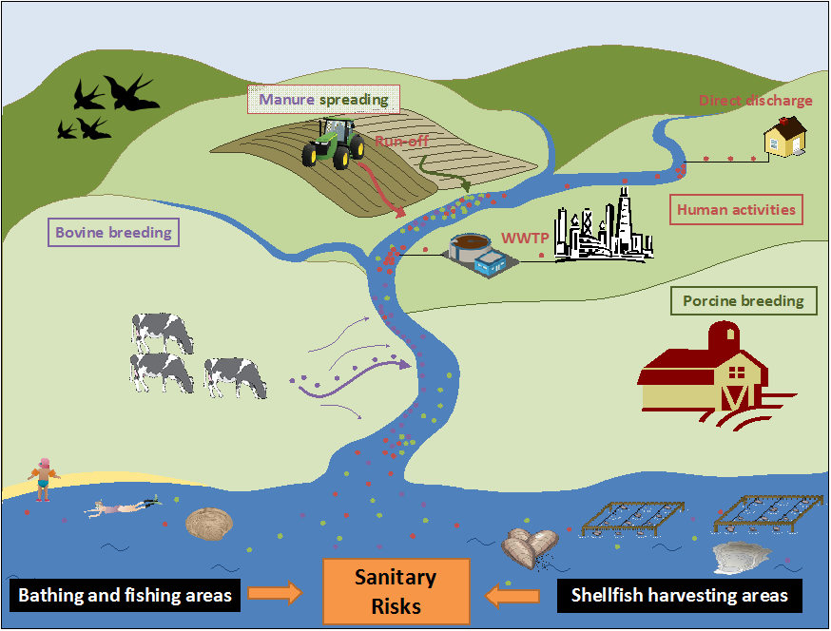
Campylobacter: linkink foodborne and waterborne diseases
Interplay between foodborne and waterborne
Concept of One-Health!

Slide 18
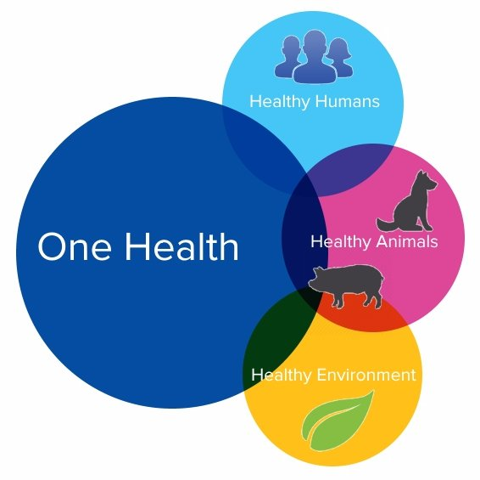
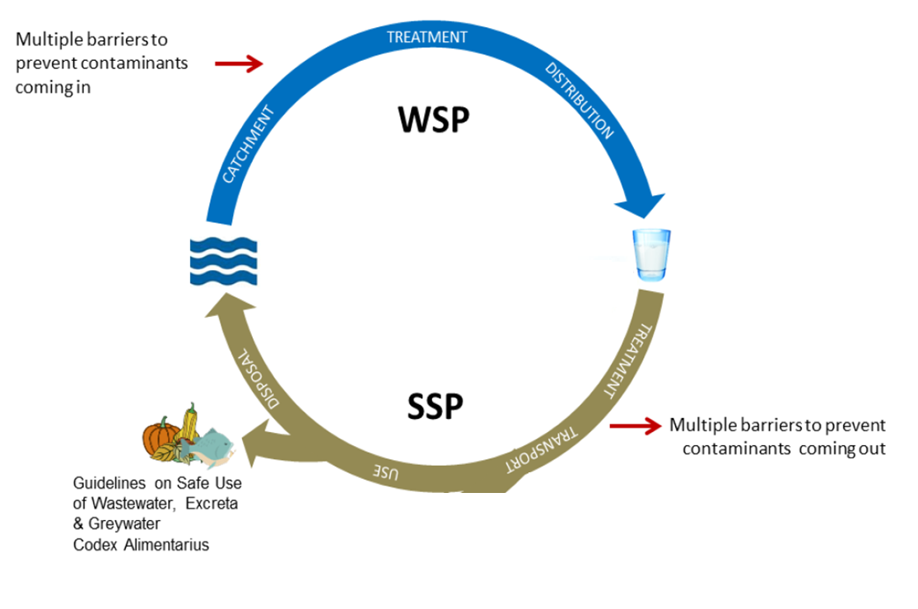
New conceptual framework of water management
+

Slide 19
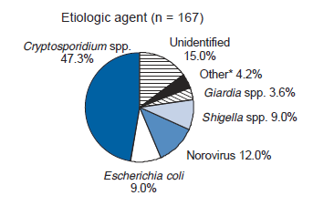
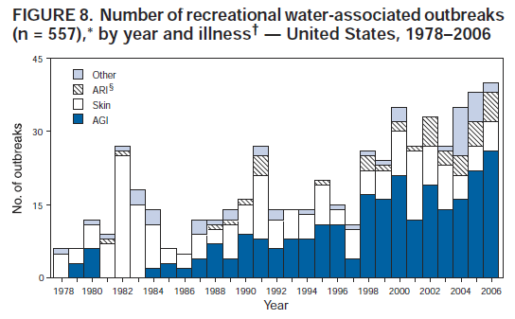
And in Recreational waters?
Campylobacter?

Slide 20
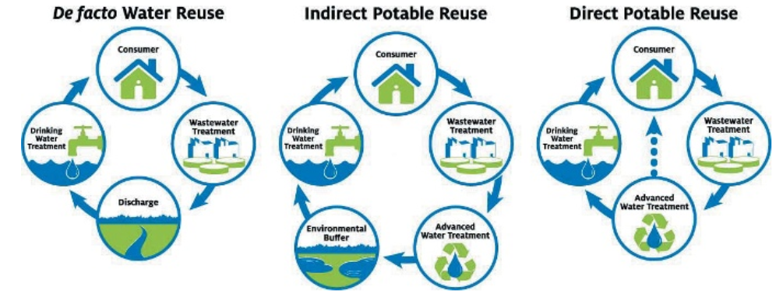
Next challenges: the evolution of water reuse

Slide 21

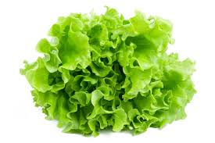


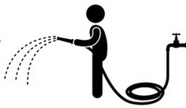
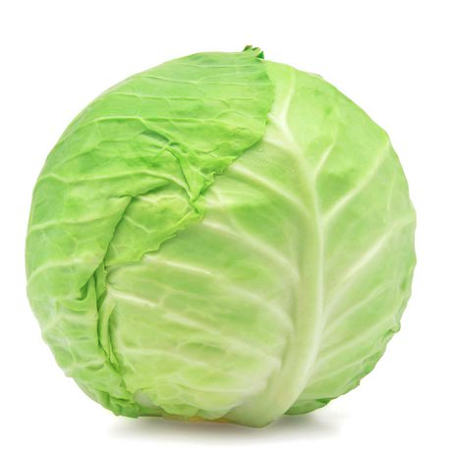



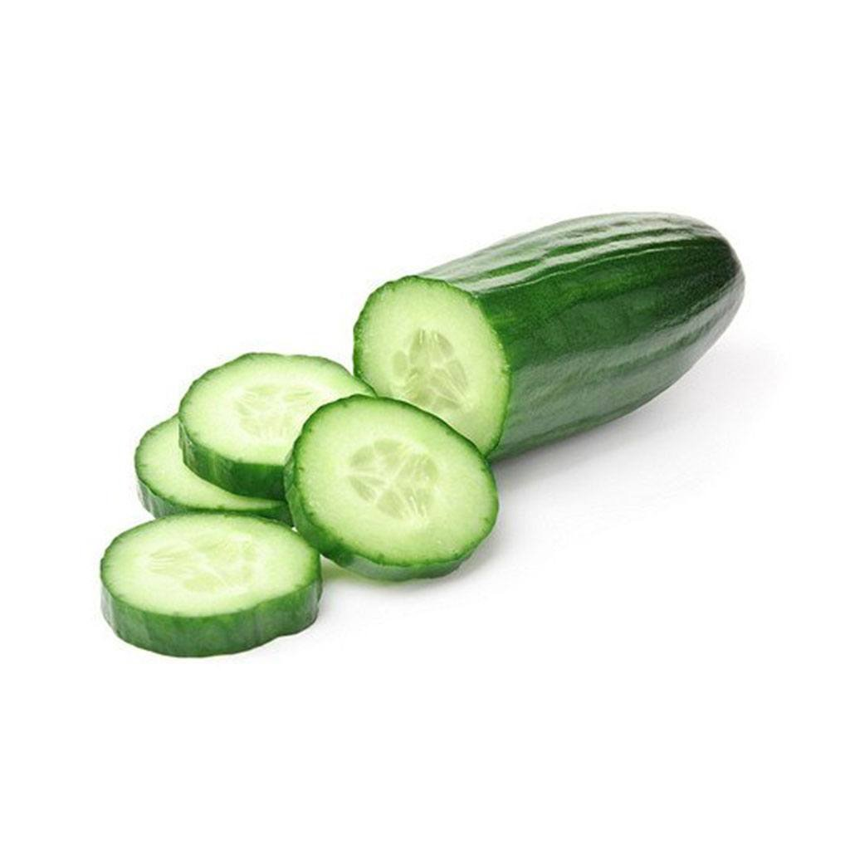

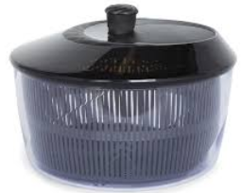
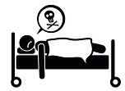


Quantitative microbial risk assessment
Hazard identification : Salmonella enterica
Exposure assessment
Amha et al., 2015. A probabilistic QMRA of Salmonella in direct agricultural reuse of treated wastewater. Wat Sci Technol 71.8: 1203-1211.

Slide 22
How works QMRA ?
Exposure assessment
Determination of the ingested dose (λ): probabilistic approach
C_{path} .e^{-kt} .V_{prod}.10^{-w}.M_{ing}.M_{corp}= λ
C_{path}
t

Slide 23
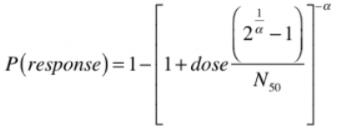
Comment est construit un QMRA?
Exposure assessment
For one isolated ingestion
When exposure is repeated n times P_{annual} = 1 – [1- P(response)]^{n}
DALYs = P_{annual} . DALY_{per case} . S_{fraction}

Slide 24
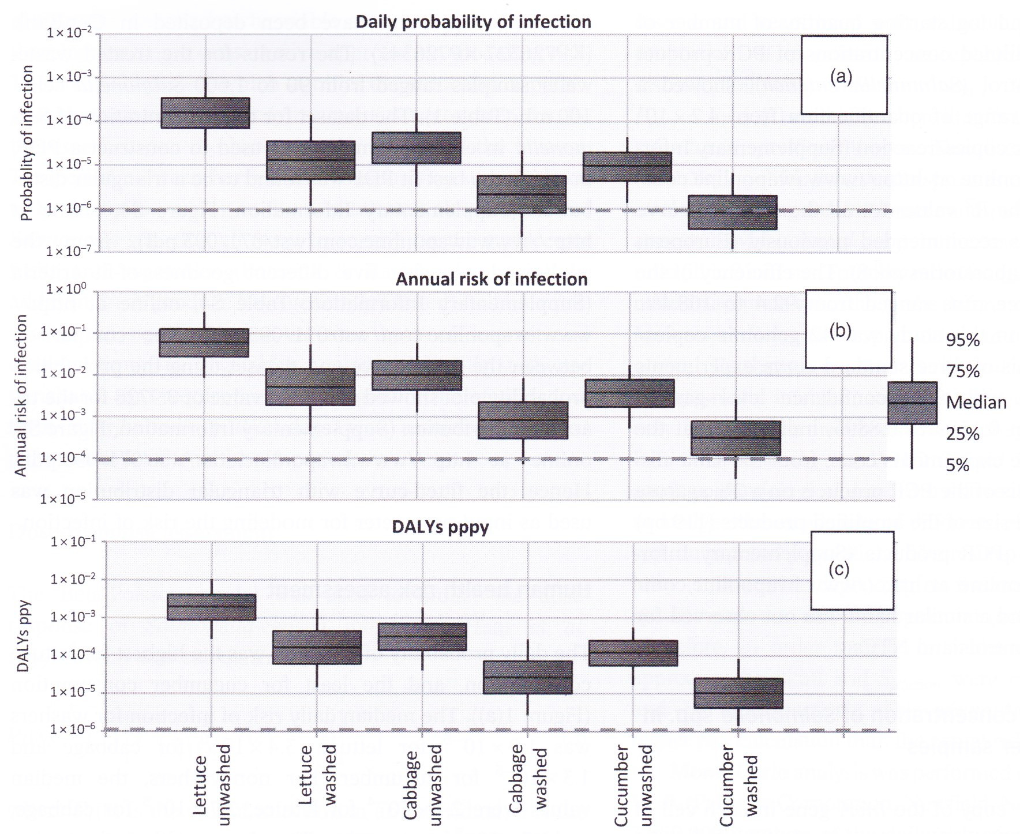
Results
Acceptable annual risk USEPA
Acceptable annual risk USEPA
Acceptable annual risk USEPA

Slide 25
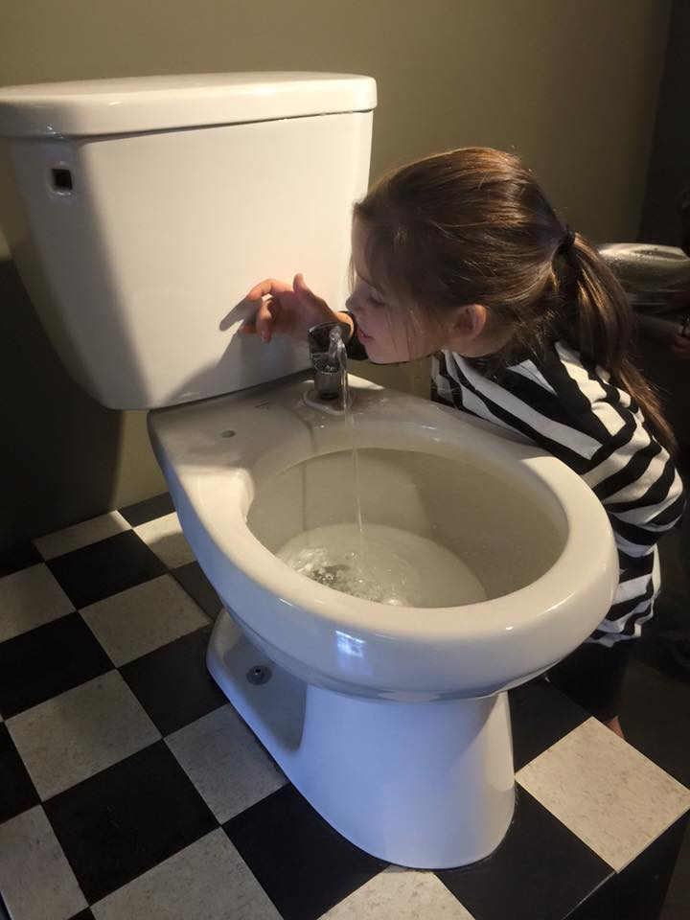
Cultural barriers

Slide 26


Evolution of the european legislation
Water reuse risk management plan

Slide 27
Cyanobacteria
Hepatotoxins
(microcystins)
Neurototoxins
(Saxitoxin
Anatoxin-a)
Dermatotoxins
(lungbyatoxin)
Cytotoxins
(cylindrospermopsin)
Notes:
So we have the suspect. But the first thing is to know the prevalence

Slide 28




Development in Europe

Slide 29

Evolution of legislation

Slide 30
chalLenges related to the cyanobacteria
No in situ treatment except the management of eutrophication on the long term and large scales.
Oxydation treatments are however efficient (pay attention to the governance)
How to integrate the high spatial and temporal variability in the monitoring schemes

Slide 31



Real-time monitoring and spatialisation of cyanobacteria occurence

Slide 32

A global health safety plan
Drinking water
Food production
Wastewater
Recreational water
Water reuse
Less automatic application of legislation
More locally adapted risk based analysis

